Slide 1
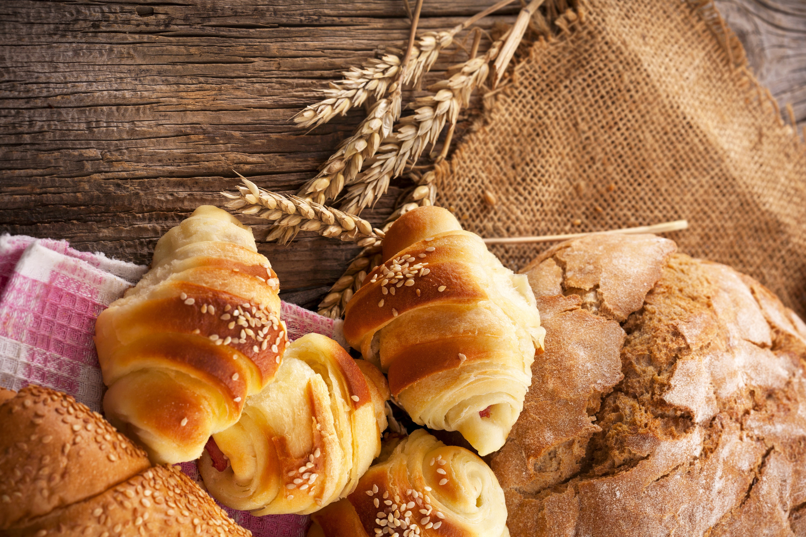






RECIPE BOOK
Bringing Joy, One Bite at a Time

Slide 2
INTRODUCTION
NAME: DIYA SONI
DIPLOMA -IT
SEM-3
ENROLLMENT NO.: 24C15066
JAVA SCRIPT PROJECT-
RECIPE BOOK

Slide 3
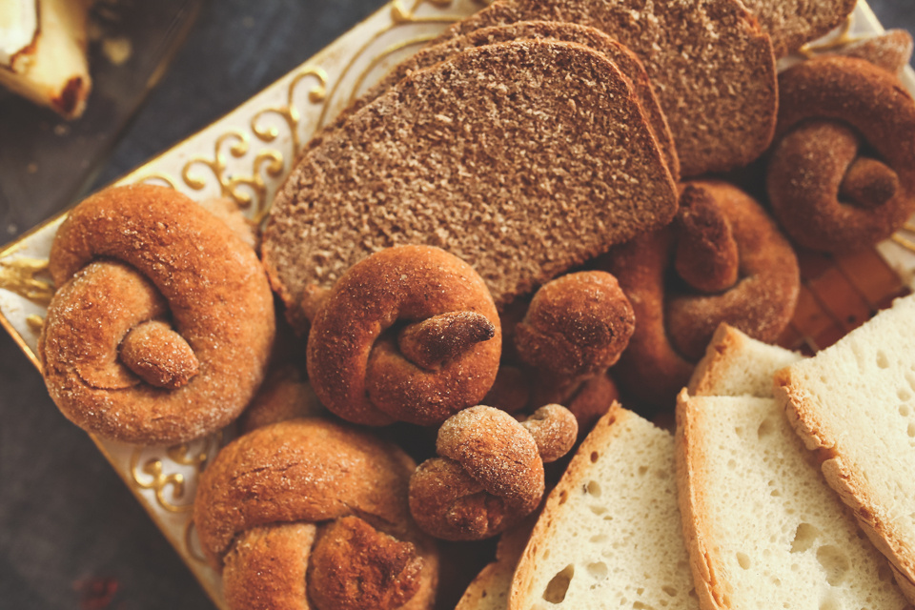
WHY IT IS USEFUL?
Recipe book websites are useful because they offer vast collections of recipes that are easily searchable, can be organized in many ways, and often include nutritional information. They provide immediate access to a huge variety of dishes, helping users find recipes based on ingredients they have on hand, dietary needs, or desired cuisine, which can help with meal planning and experimenting with new dishes to improve cooking skills.

Slide 4

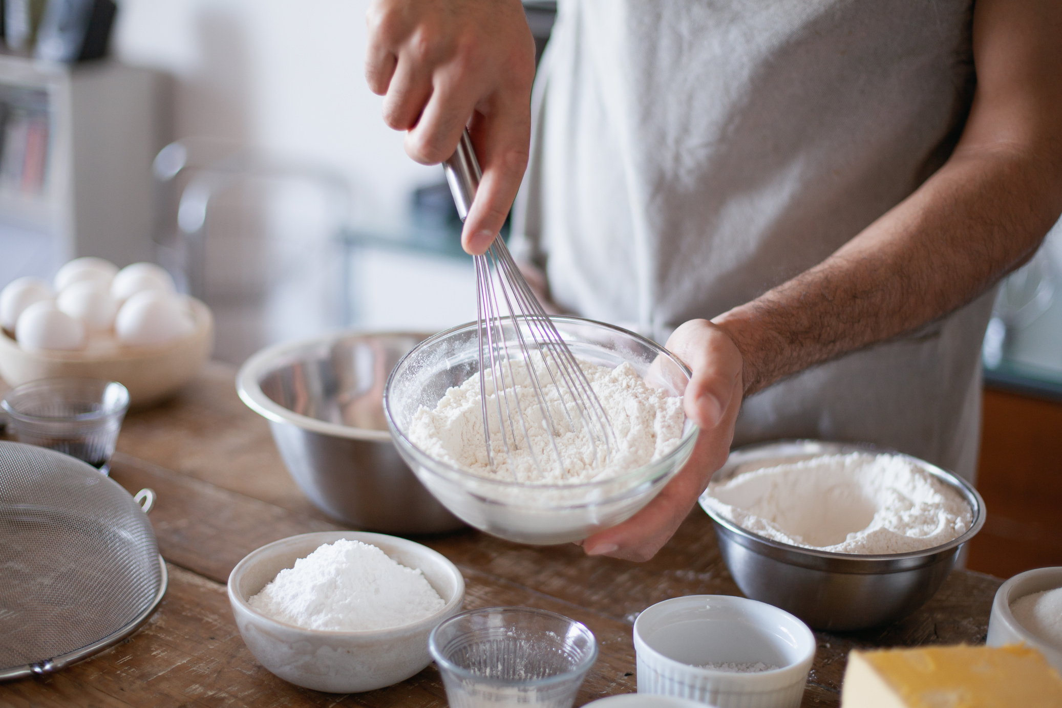
INFORMATION
ABOUT US
Welcome to Recipe Book! I am passionate about making delicious food accessible to everyone, from beginner cooks to seasoned chefs. My goal is to be your go-to source for easy-to-follow, creative, and reliable recipes that inspire you in the kitchen.
We believe that cooking should be a source of joy and creativity, not frustration. We aim to demystify cooking and help you build confidence in the kitchen by providing quality recipes and resources. Whether you're looking for a classic comfort food or a new culinary adventure, we're here to help you cook with confidence and make every meal a celebration.

Slide 5
THANK YOU!

